Slide 1
Aditya’s Data Visualization Project Mutual Fund Multi-Factor Analysis
A comprehensive analysis of mutual fund performance based on returns, risk, and expense ratios.

Slide 2
objective
The analysis combines multiple variables: returns (1yr, 3yr, 5yr), risk metrics (standard deviation, beta, Sharpe ratio), and expense ratio.
Using weighted scoring, we aim to rank mutual funds based on their overall performance.
The goal is to provide actionable insights for selecting funds that offer the best balance between risk, return, and cost.
Understand the tradeoff between risk and return by analyzing how funds perform across different risk levels (low, moderate, high).
This will highlight which funds offer the best risk-adjusted returns for investors.

Slide 3
Problem statement / Project scope
Objective Selection: Investors require a data-driven method to choose mutual funds that align with their risk tolerance and return expectations.
Comprehensive Evaluation: It's essential to assess returns alongside risk metrics like standard deviation and beta to gauge fund performance accurately.
Expense Ratio Impact: Understanding how expense ratios influence performance is vital for informed investment decisions.
Risk-Return Analysis: The analysis covers both short-term and long-term returns across varying risk levels: low, moderate, and high.
Top-Performing Funds: Focus is on identifying top-performing funds through a weighted combination of returns, risk, and expenses.

Slide 4
Solution approach
Data Collection: Gather data on mutual funds, including returns, risk metrics, and expense ratios.
Risk Classification: Categorize funds by risk levels (low, moderate, high) based on volatility.
Performance Metrics: Assess short-term and long-term returns for each fund.
Risk-Adjusted Returns: Use measures like the Sharpe ratio to evaluate performance relative to risk.
Weighted Evaluation: Create a scoring system combining returns, risk, and expenses for fund ranking.
Visualization Tools: Use tools like Power BI for clear data presentation and fund comparisons.

Slide 5
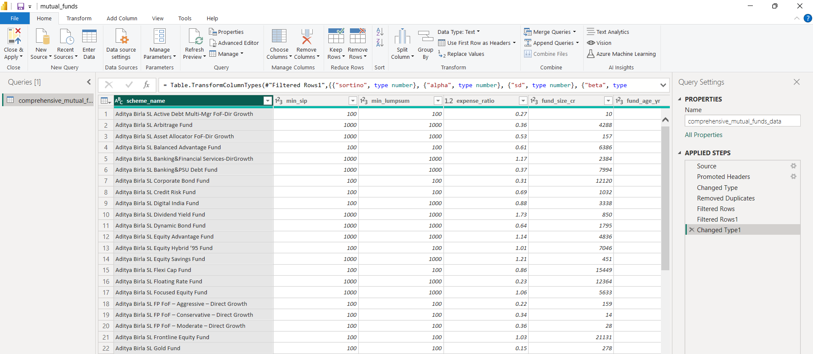
Data cleaning/transformation in Power Query

Slide 6
Solution approach
Some imp ratios
sortino: Sortino ratio, measuring risk-adjusted returns focusing on downside risk.
alpha: Alpha, indicating the fund's performance relative to the market benchmark.
sd: Standard deviation, showing the fund's volatility.
beta: Beta, measuring the fund's sensitivity to market movements.
sharpe: Sharpe ratio, indicating risk-adjusted returns.

Slide 7
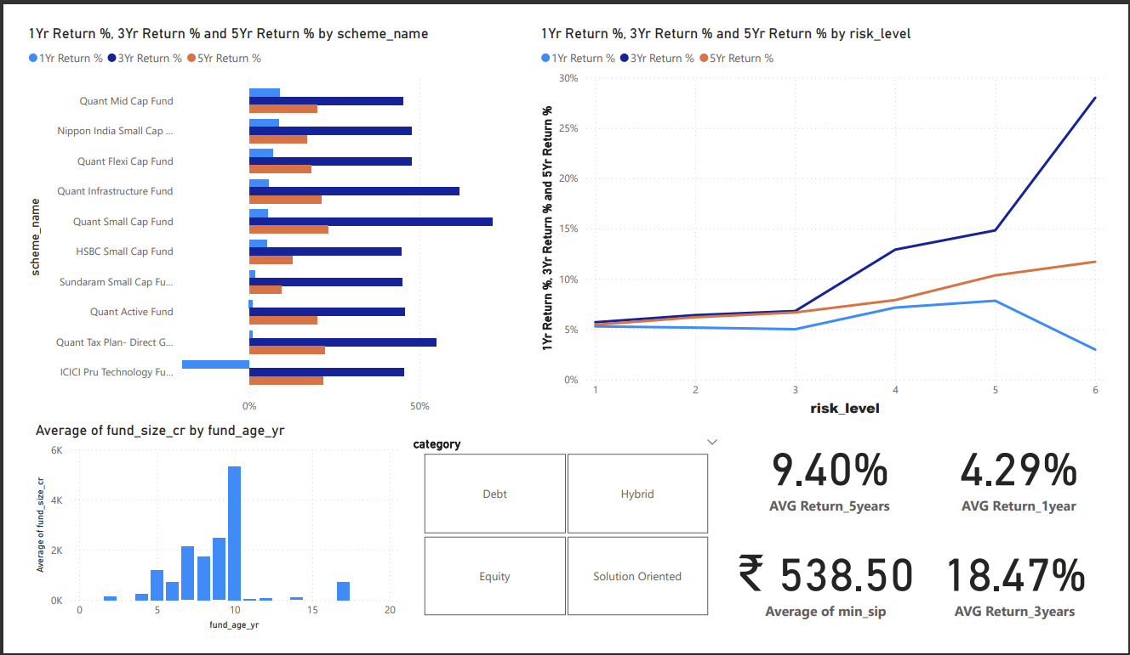
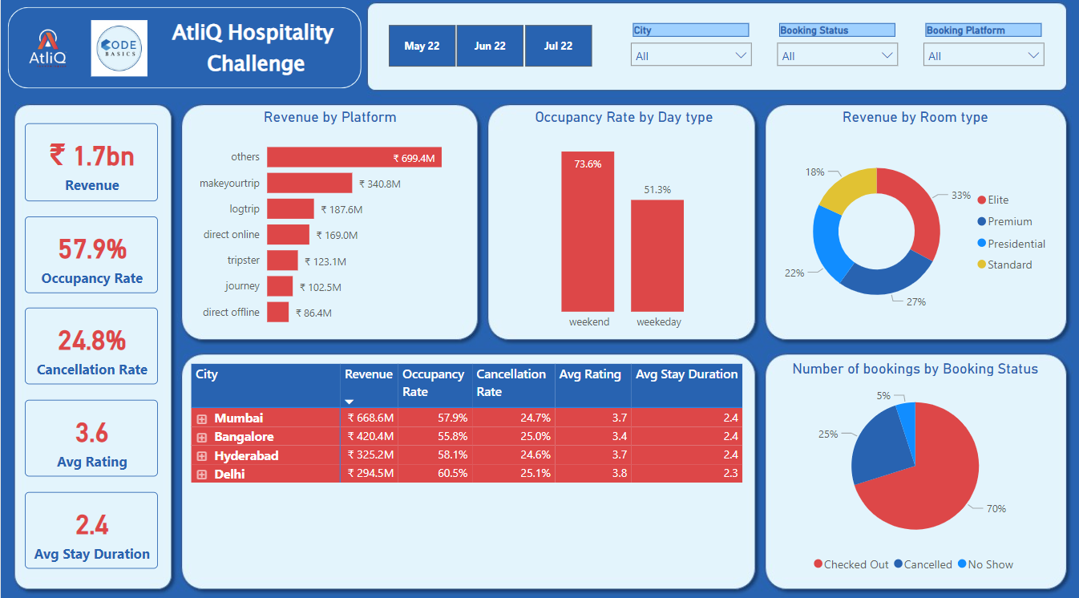
Dashboard

Slide 8
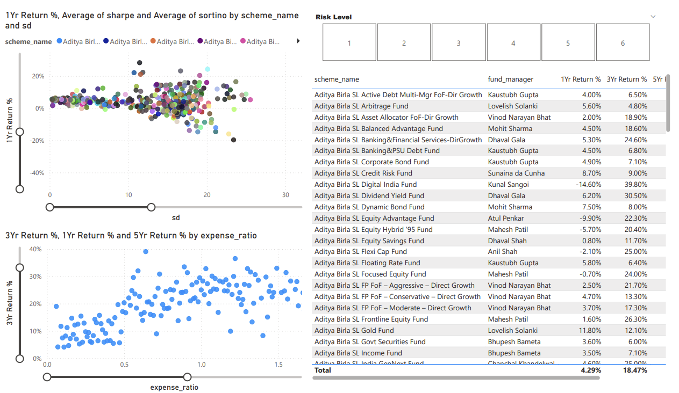

Slide 9
Features of the dashboard
Interactive Graphs : Top Graph (1Yr Return % vs SD): Scatter plot showing the relationship between the 1-year return percentage and standard deviation (volatility) for various mutual fund schemes, color-coded by scheme name.
Bottom Graph (3Yr Return % vs Expense Ratio): Scatter plot displaying the relationship between the 3-year return percentage and expense ratio, providing insights into how fund costs impact performance.
Risk Level Filter : A numeric risk level filter ranging from 1 to 6 allows users to filter schemes based on their risk category, potentially highlighting funds with varying levels of risk.
Fund Details Table : A detailed table listing the scheme names, fund managers, and key performance indicators such as 1-year, 3-year, and 5-year return percentages.
This table helps users compare the performance of different funds managed by various fund managers.

Slide 10
Features of the dashboard
Color-Coded Scheme Names : Schemes are represented by unique colors in the scatter plots for easy visual identification and comparison across the graphs.
Expense Ratio vs Returns Analysis : The bottom graph directly correlates expense ratio (fund cost) with returns over 1, 3, and 5 years, enabling users to gauge the cost-effectiveness of funds.
Performance Highlights : The total averages for 1-year and 3-year returns are shown at the bottom of the table, offering a quick summary of the fund performance.
Scrollable and Filterable Data : The fund details table is scrollable, allowing users to explore more funds and their corresponding performance data as per their interest.

Slide 11
Analysis outcomes
The following are some important insights derived from the dashboard:
The 3-year average return of 18.47% significantly outperforms both the 1-year average return of 4.29% and the 5-year average return of 9.40%, highlighting stronger mid-term growth compared to shorter and longer-term performance.
The Bank of India Credit Risk Fund achieved an exceptional 130% return in 1 year, the highest in its category, but with high volatility (SD of 77.72). It is classified as risk level 4 in the debt category, suggesting a high-risk, high-reward profile.
The majority of funds have a 1-year return of 5.20%, with a risk level of 2, beta of 0.14, average Sharpe ratio of 1.14, and average Sortino ratio of 6.28.

Slide 12
Analysis outcomes
For 3 year Returns:-
Quant Small Cap Fund delivers the highest return at 77.40% over 3 years, showcasing strong growth potential .
Majority of returns are achieved with an expense ratio between 1% to 2%, or possibly lower, indicating cost efficiency.
As risk level increases, returns also increase in a non-linear fashion, highlighting the risk-return tradeoff.
Equity funds consistently offer higher returns compared to other categories like debt and hybrid, making them more attractive for long-term investors.
Funds with higher volatility tend to show greater growth, but come with increased risk.

Slide 13
Analysisoutcomes
for 5-year returns:
The majority of Alpha ratios lie between -5 to +15 for funds with returns ranging from 2% to 15%.
The Beta ratio ranges between 5% to 15% for funds with returns between 2% and 15%.
Quant Small Cap Fund, managed by Sanjeer Sharma, delivers the highest return at 23% over 5 years, which is lower than its 3-year return of 77.40%.

Slide 14
Conclusion
Mid-term growth (3-year returns of 18.47%) outperforms both short-term (1-year return of 4.29%) and long-term (5-year return of 9.40%) performance, indicating stronger growth potential in the intermediate period.
Equity funds tend to offer higher returns compared to debt and hybrid funds, with higher volatility correlating with greater growth but also increased risk, making them suitable for long-term investors with higher risk tolerance.
Expense ratios between 1% and 2% contribute to cost efficiency, while risk levels and beta ratios highlight the tradeoff between risk and return, with higher risk leading to the potential for higher returns.

Slide 15
Thank you!

